Slide 1

MIS 665 Final Project
By: John Austin Smith

Slide 2
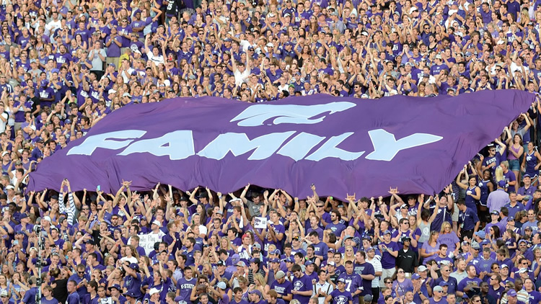
Project Description
Our final project was to help a sports marketing team discover trends in the data given to us that would help them produce a predictive model to help identify fans that are the most likely to defect and not renew their season tickets for the following year.
We needed to build a scoring model that corresponded to the likelihood of renewal based on the variables given in our data, this way the marketing team could intervene and try to retain the at risk customers for the next year.

Slide 3
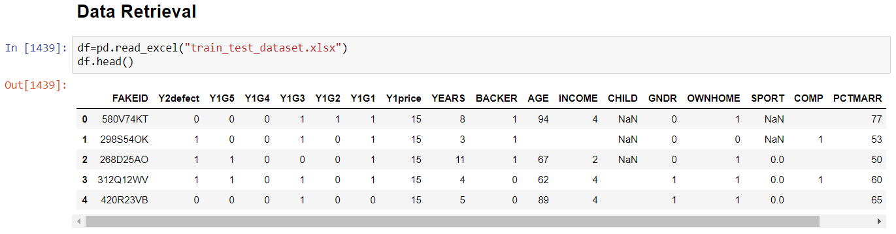
Introduction
Data Retrieval: Retrieving the data from the sports marketing team.

Slide 4
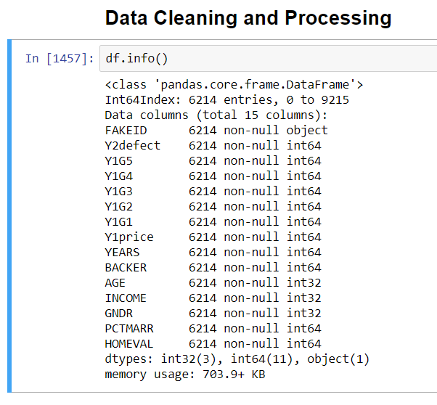
Introduction
Data Cleaning: Cleaning the data so that it can be visualized, explored, and eventually modeled for predictive capabilities.

Slide 5
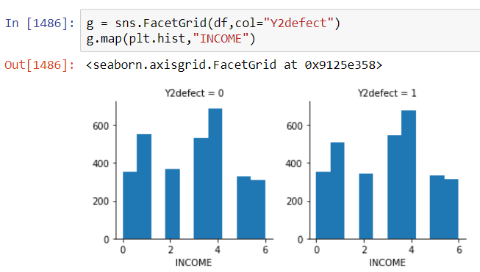
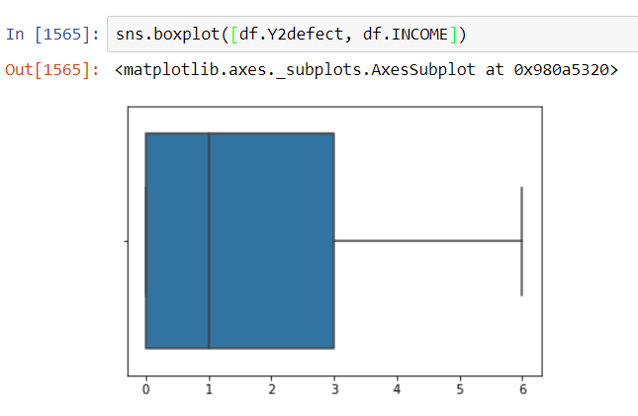
Introduction
Data Visualization: Visualize the data to find trends in the variables.

Slide 6
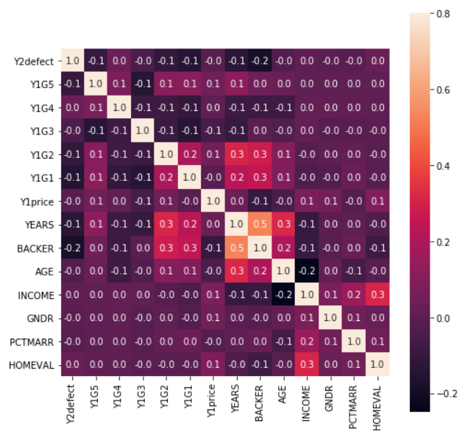
Introduction
Data Exploration: Utilize the trends found in data visualization to find correlations in the data that can be used to create models.

Slide 7
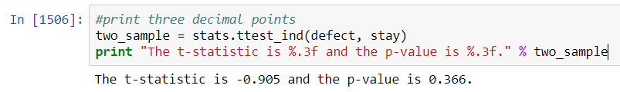
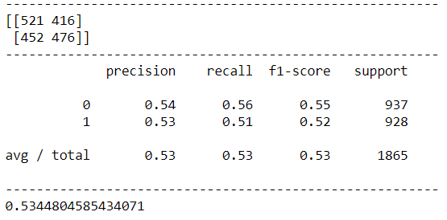
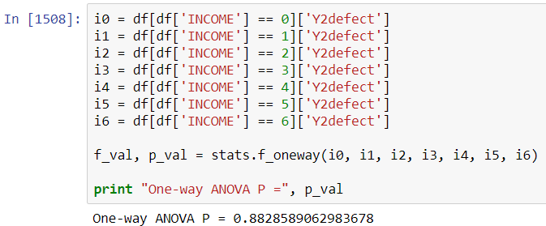
Introduction
Model Building: Build a model that will assist in predictions potential defects in season ticket holders.

Slide 8
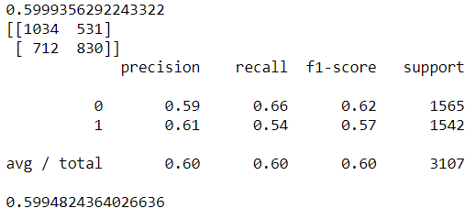
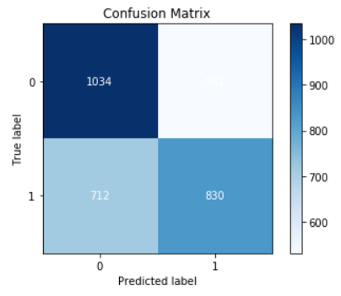
Introduction
Model Selection: Select the best model that will prove to be the most helpful and accurate in discovering who will likely not renew their tickets for the following season.

Slide 9
Key Findings
I found that a lot of the data provided had no correlation to not renewing. A lot of the time the difference between defecting or not were slim.
Important Variables;
BACKER: Whether or not the ticket holder was a member of the teams “Backer” club or not.
Y1G1: Attended the 1st home game of the season.
Y1G3: Attended the 1st home game of the season.
Y1G5: Attended the 1st home game of the season.

Slide 10
“BACKER” Variable
BACKER: Whether or not the ticket holder was a member of the teams “Backer” club or not.
0 = Not a member of the team’s “backer” club
1 = Is a member of the team’s “backer” club
This has a correlation to ticket holders defecting if they are not members of the club.

Slide 11
“Games Attended” Variables
Y1G1: Attended the 1st home game of the season.
Y1G3: Attended the 1st home game of the season.
Y1G5: Attended the 1st home game of the season.
0 = Tickets not being used for the specific game.
1 = Tickets being used for the specific game.
This has a correlation to ticket holders defecting when they are not utilizing the tickets they paid for during the previous season.

Slide 12
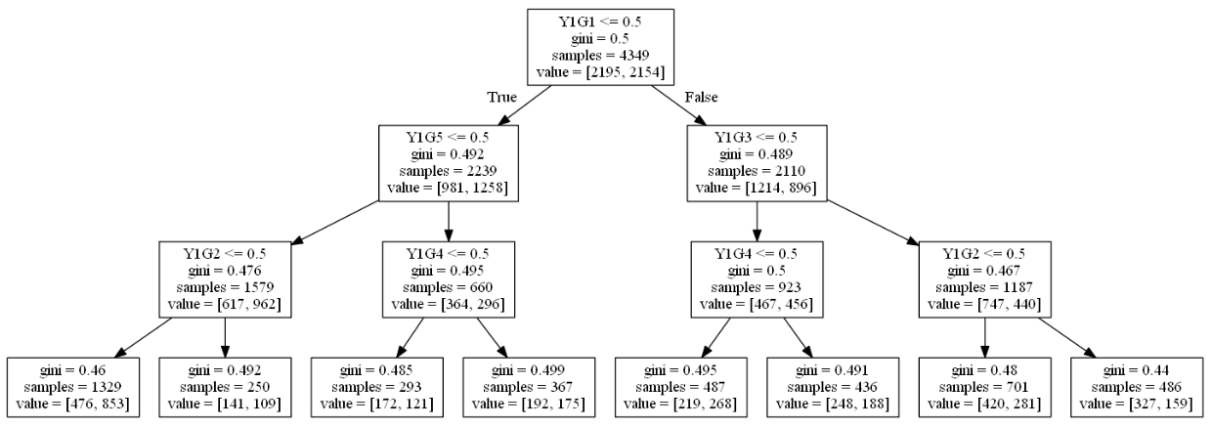
Best Classification Model
Decision Tree Classifier: flow-chart-like structure, has different nodes that holds a test on a variable, each branch off a node is a different outcome.
The accuracy of my decision tree classifier model was 59.95%.

Slide 13
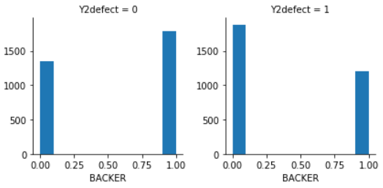
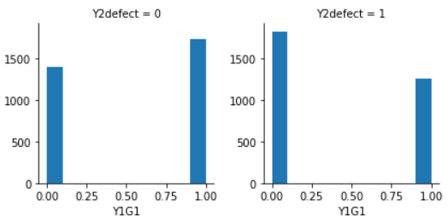
Storytelling
Who is likely to renew? Backer members that attend most games and have an average or above average income.
Who is likely to defect? Non backer members that do not attend most games and have a below average income.

Slide 14
What else?
What actions do you recommend K-State Athletic Department (or other sports teams) to take? Calling the previous seasons ticket holders that are not members of the “Backers” club and didn’t make it to most of the games.
What additional variables would you need to improve the model prediction? Teams ending record (i.e. Winning season, Lossing season), Home game outcome (i.e. Win, Loss), Year by year price difference.

Slide 15
THE END.
Thank you for viewing, I hope this was helpful information. Have a great summer.

